Slide 1
Communicative English
Words and phrases for self – introduction

Slide 2
Ex 1
I am XYZ
I am a Chill and Easy guy - carefree, even tempered
I don't take much tension into my head – relaxed
I like to know stuff – curiosity
According to me learning other things and possessing other
skills are also equally important well informed - knowledge seeker

Slide 3
Ex 2
My strength is that I can take any challenges even the ones that I know has very less success rate – willingness to take any task
It is the thought that “until you try, you never know” making me take up challenges – daring – confident
I don’t see failure as a negativity but as a bump on the path of my success – positive attitude – optimistic
my weakness I do not have good experience at public speaking – stage fear, audience shy, nervous
I know have a lot of room to improve my public speaking skills but I am getting there, One step at a time.- hopeful, cheerful and never say die attitude

Slide 4
Ex 3
Let me tell you right off the bat that I tend to procrastinate too often, this is a quality of mine that I seek to improve, however when I gain interest in a topic, I try my level best to excel in it.- passionate about interested areas, frank
An example of this is my attitude toward physics and chemistry. I love physics and find it as one of the most intriguing subjects I've come across in my school life.
In contrast, chemistry is a subject I absolutely despise and dread having to study. This is evident in my board marks. I also tend to grasp knowledge quickly.
(One of the best write up I received in terms of the content)

Slide 5
Ex 4
Regarding my qualities, i would like to mention that i am a very honest, creative, self-disciplined and a down to earth person.
But however, i would like to be more hard working and socializing in the future.
The reason why i have decided to join engineering profession (ECE - Electronics and communication) is because of my keen interest in creative and skilled activities related to my course.
(One of the introductions which was worded well. Good vocabulary used)

Slide 6
Ex 5
I'm an enthusiastic learner, I have fair communication skills.
I'd like to improve my confidence level when I'm interacting with many people. - introverted
Matter of fact 5 lines.

Slide 7
Ex 6
I would say my biggest qualities are being open minded, and thinking out of the box- lateral thinking
I'm also creative minded - artistic
I tend to not apply myself enough, and hence miss out on opportunities to be taken – laidback, unsure
I'm also not a very keen risk taker- cautious
The reason I've choosen engineering, and information science in particular is because I find that this course requires a good blend of analytical skills and creativity. It's fits in with my abilities and interests. – blend of academic interests with chosen filed
This course gives us a head start on our learning, and is especially beneficial for the students who are new to our culture and curriculum – (referring to bridge course?)
I am keenly looking forward to being part of this course.

Slide 8
Ex 8
I would describe myself as a hard-working person who is eager to learn new things – diligent
I can understand things quickly and I am quite good at remembering new information. – sharp grasping and analytical skills
In addition, I have always been good with many sports such as football, handball, table tennis, badminton and others. – athletic and sports
I can get shy and nervous from talking in front of an audience and it is a thing I would like to overcome. – introverted and anxious
I have always been good with mathematics and physics so it was one of the reasons I chose engineering in general – academic interests relate to chosen field
I would like to learn to build my own programs and create my own games one day. – Entrepreneur – innovator

Slide 9
Checklist for Self Introduction
A self-introduction explains
who you are
what you do
what others need to know about you.
You should provide a self-introduction any time you meet someone new and don't have a third party to introduce you.

Slide 10
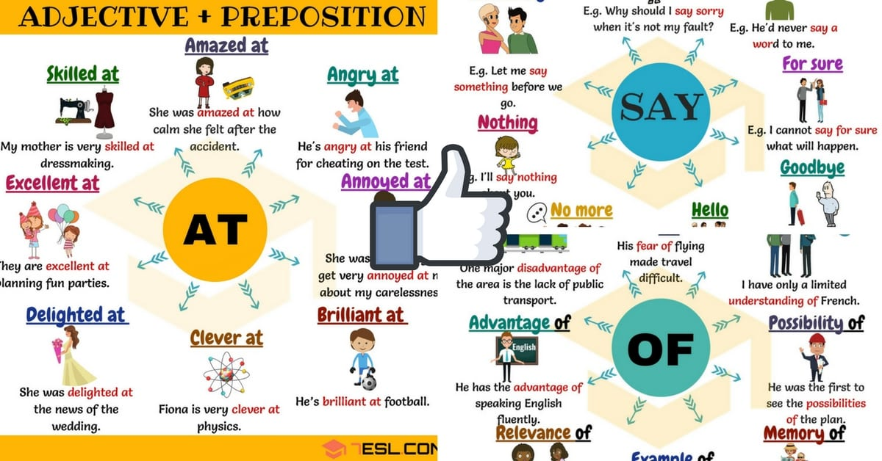
The combination of parts of speech for writing about the self

Slide 11
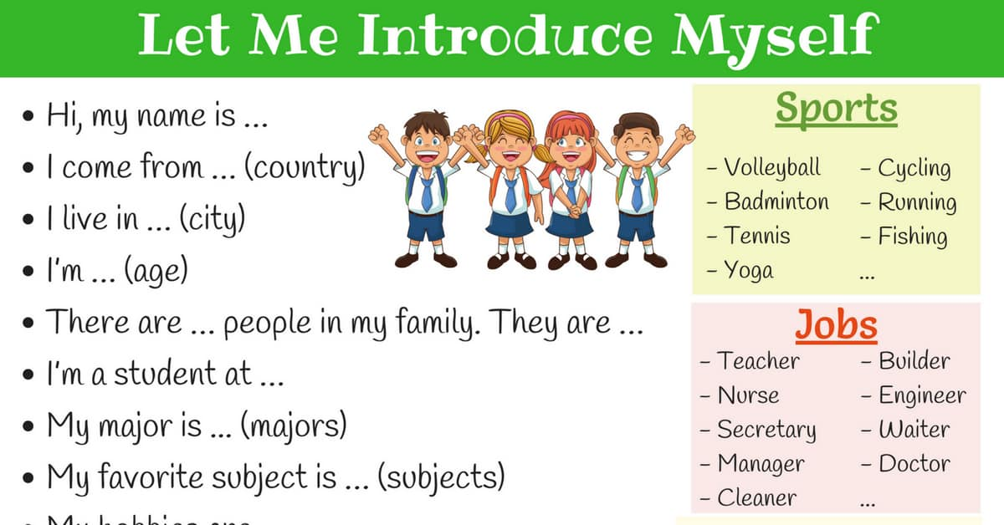
The details to be filled

Slide 12
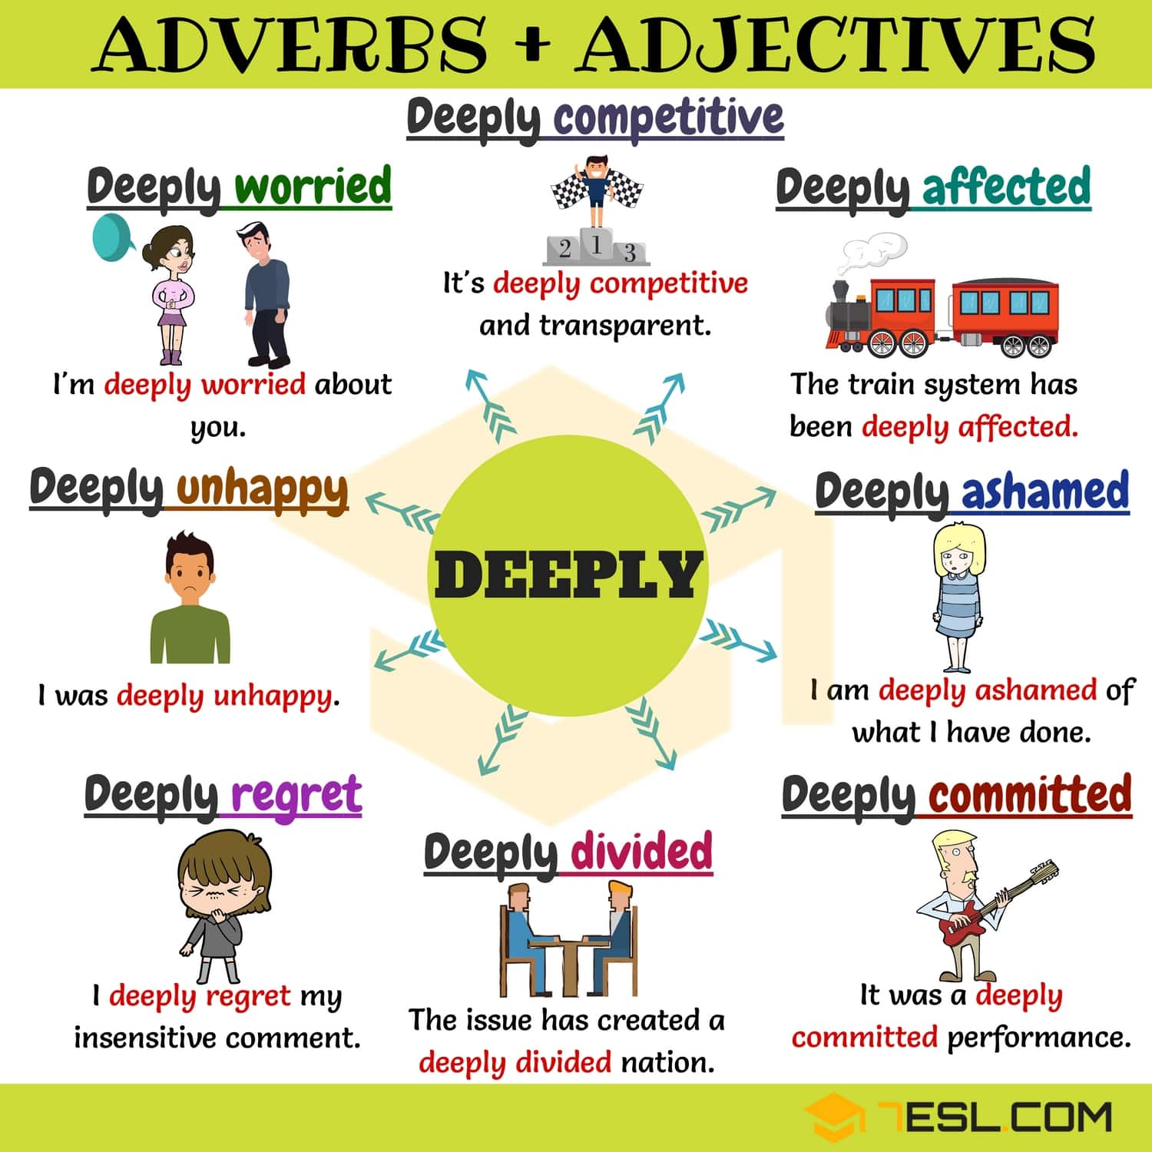
To avoid for negatives – but can be used for positive traits

Slide 13
Key terms for good self introduction
Assessment or estimate of self
Continuous improvement
Continuous learning
Knowledge of Self worth / self awareness
Appropriate words
Honest about self
Avoid exaggeration
Remain neutral

Slide 14
Respect yourself –
“If you want to be respected by others, the great thing is to respect yourself.
Thank you
Dr. Kiran Magavi

